Slide 1
Photovoltaics
Supplementary Illustrations
and Examples

Slide 2
History of Solar Energy

Slide 3
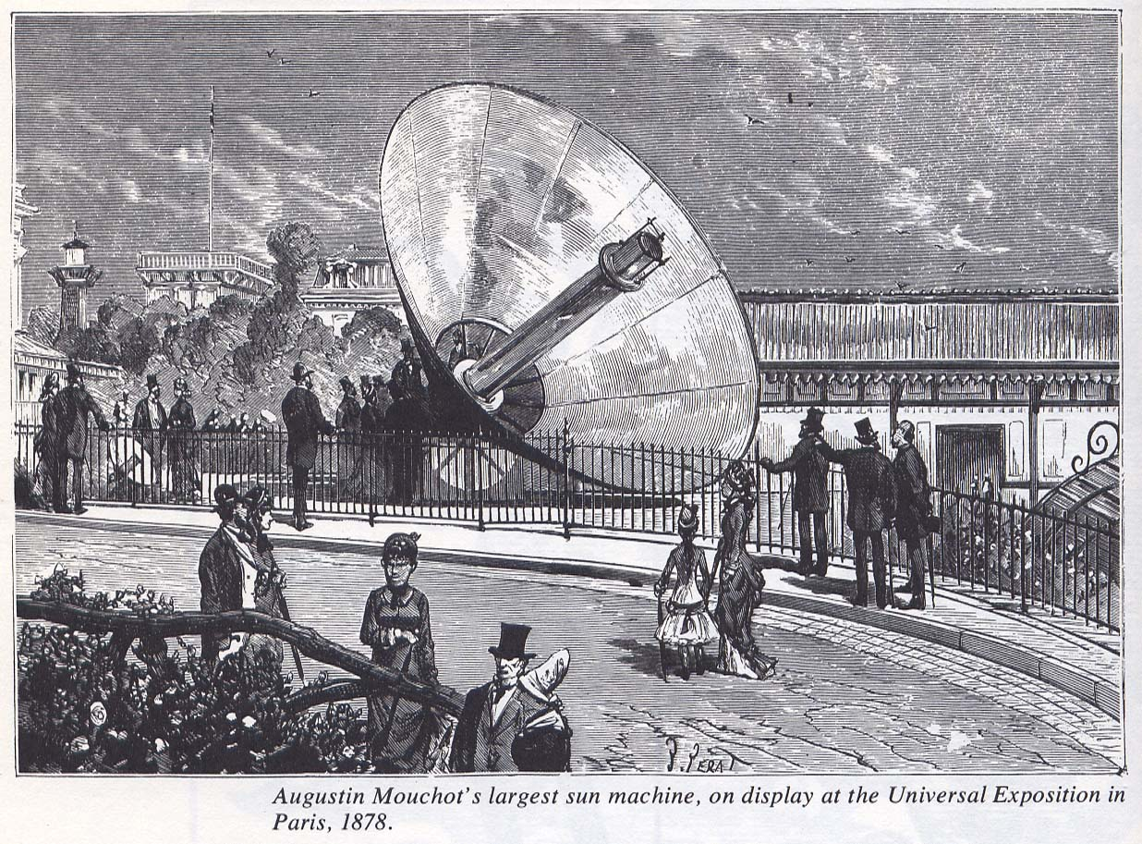
Augustin Mouchot’s largest ‘Sun Machine’, on display at the Universal Exposition in Paris, 1878

Slide 4
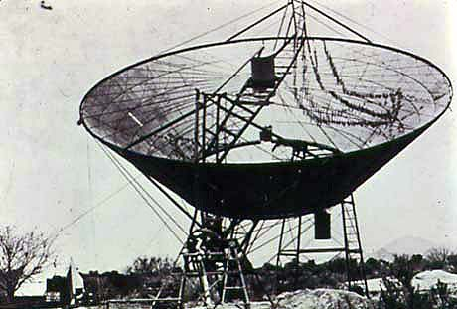
An Eneas ‘Sun Motor’ - 4 H.P. Solar Thermal Powered Steam Engine - on farm in Arizona, 1904

Slide 5
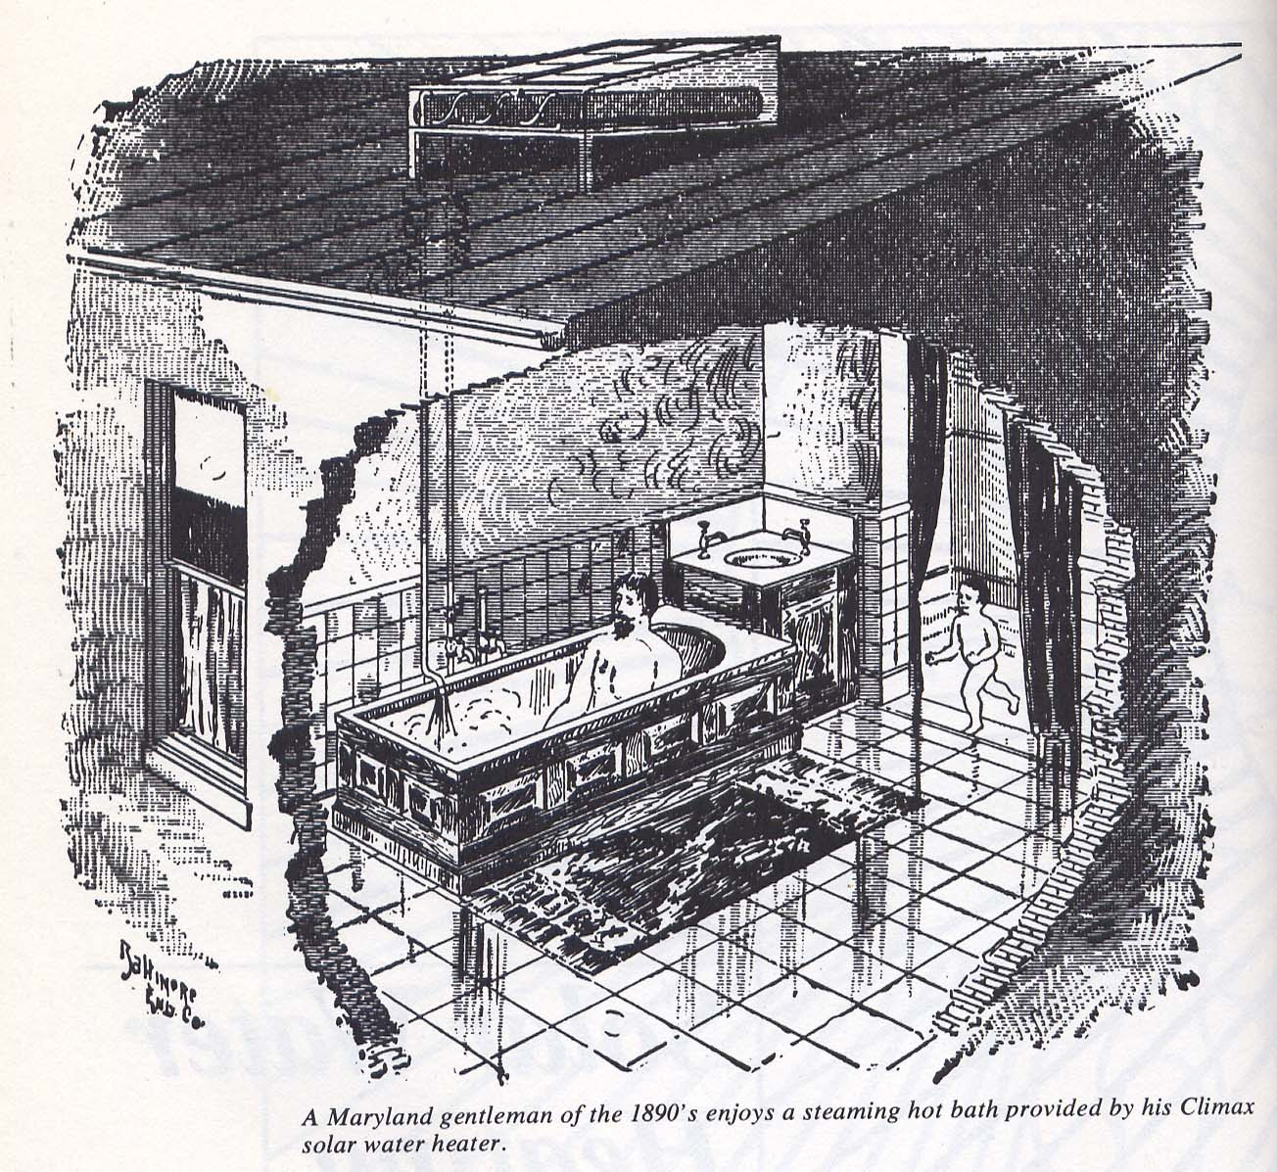
A Maryland Gentleman of the 1890’s enjoys a
Hot Bath provided by a Climax Solar Water Heater
Climax Solar Water Heaters were sold extensively between 1890 and about 1920.
Later, the Day and Night Co. was a major supplier of solar hot water systems.

Slide 6
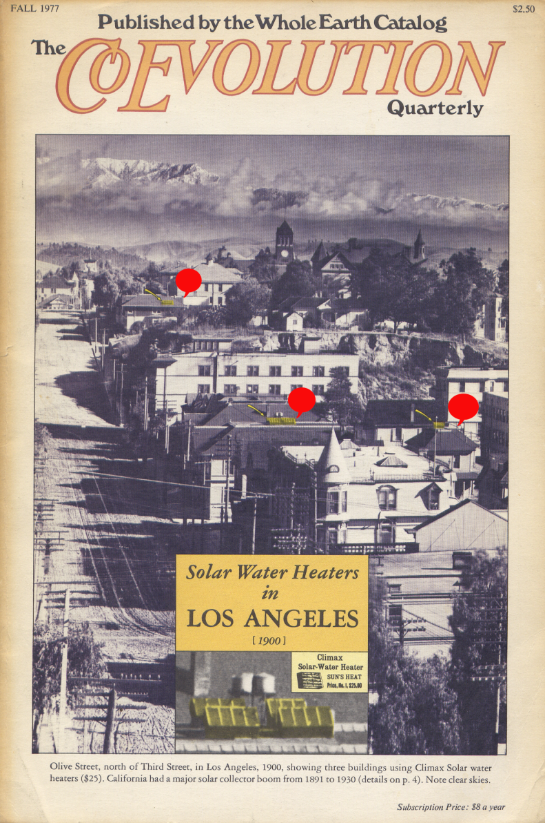
Solar Water Heating in Los Angeles, circa 1900
Olive Street in LA in 1900.
Three buildings using ‘Climax Solar’ water heaters ($25) ….
A major solar collector boom from 1891 to 1930.
(Note the ‘clear’ skies)

Slide 7
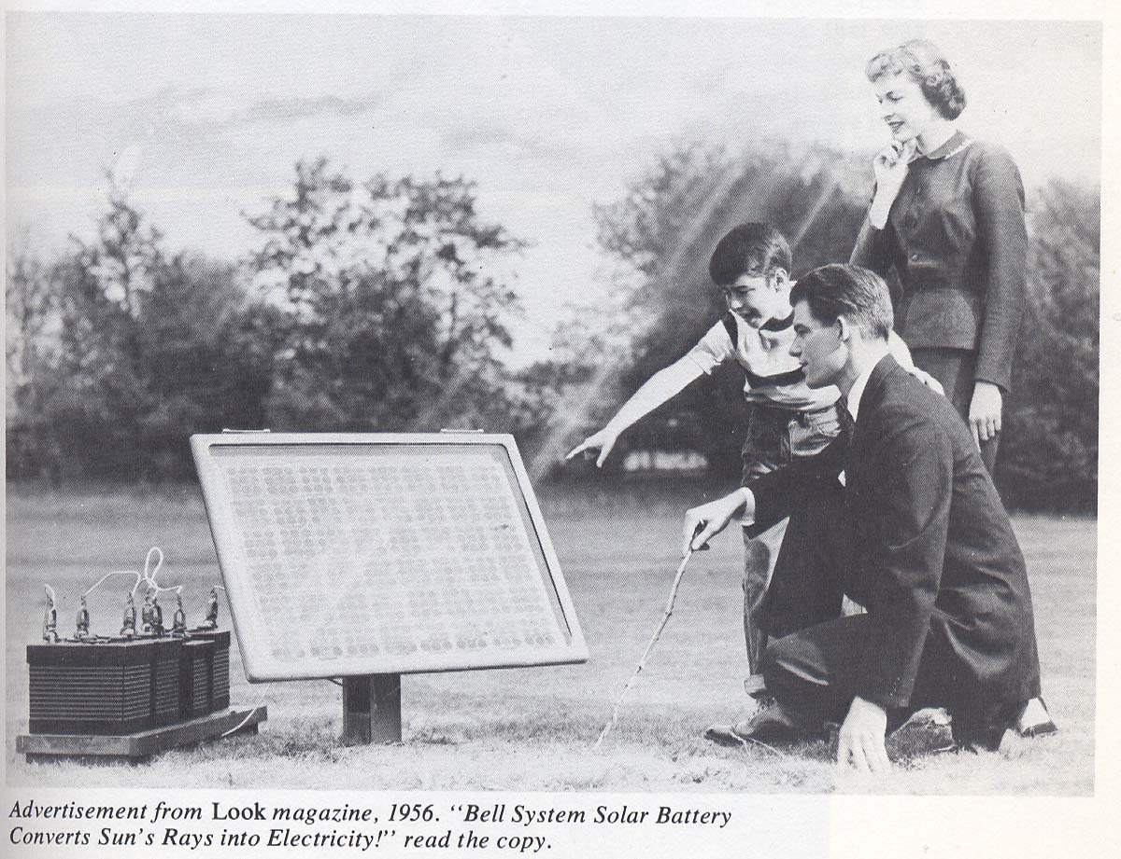
“Bell System Solar Battery Converts Sun’s Rays into Electricity”, Advertisement from Look Magazine, 1956.

Slide 8
What is Solar Energy?

Slide 9
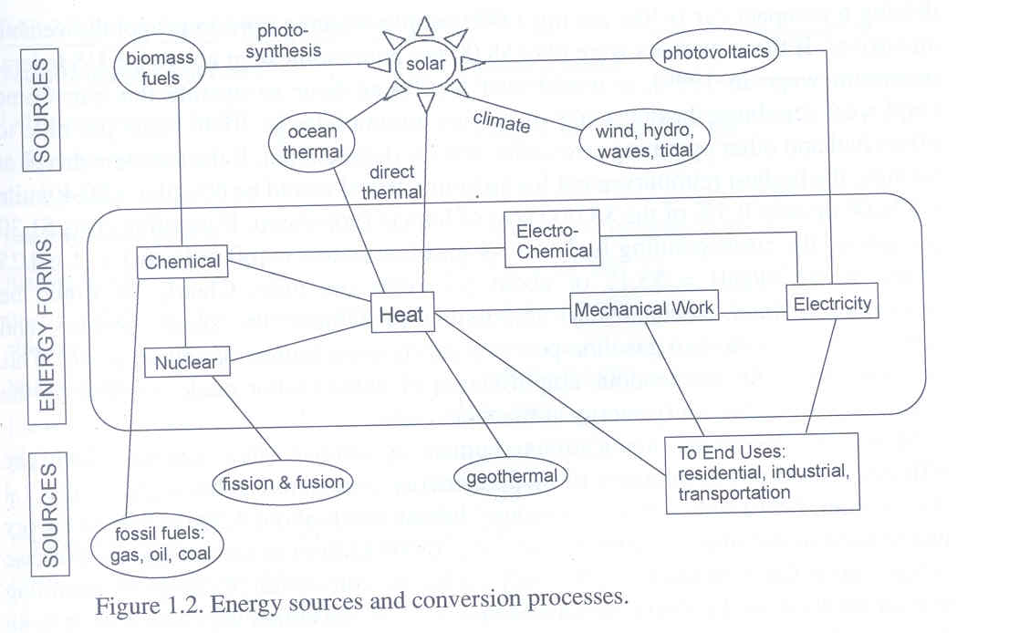

Slide 10
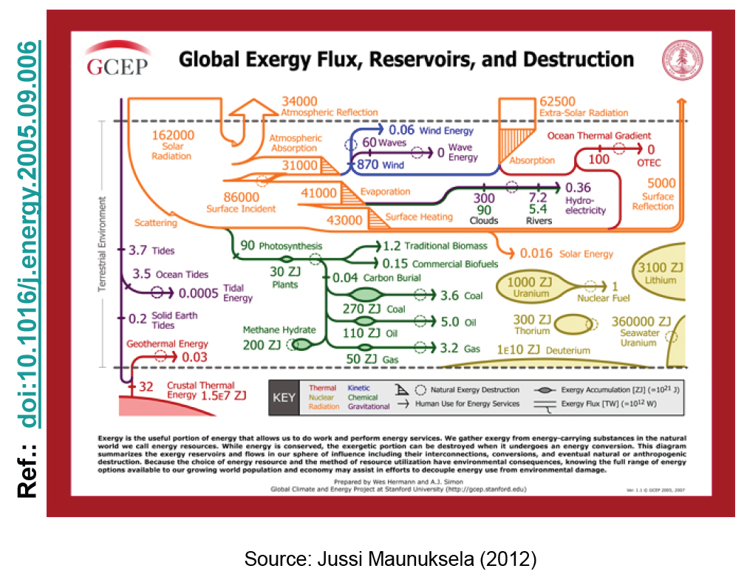

Slide 11
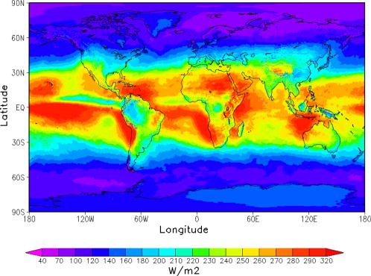
Solar Energy Distribution
Annual global mean downward solar radiation distribution at the surface

Slide 12
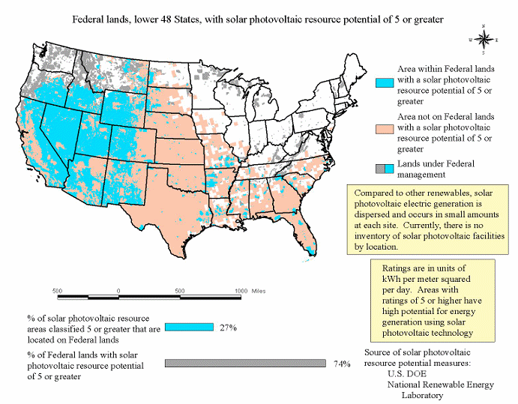

Slide 13
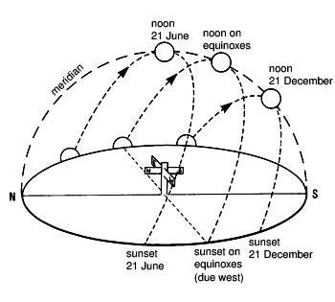
Position of the Sun (view from Earth)
Apparent placement of the Sun in the northern hemisphere

Slide 14
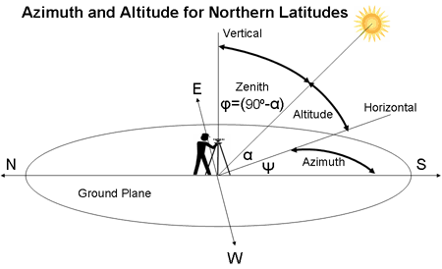
Position of the Sun (view from Earth)
Azimuth angle of the sun:
Often defined as the angle from due north in a clockwise direction. (sometimes from south)
Zenith angle of the sun:
Defined as the angle measured from vertical downward.

Slide 15
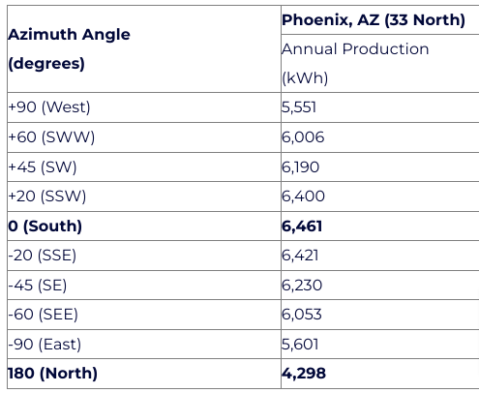
Effect of Varying Azimuth Angle
A 3.4 kW system consisting of 16x Sanyo HIT-N215A modules, tilted 20 degrees in Phoenix

Slide 16
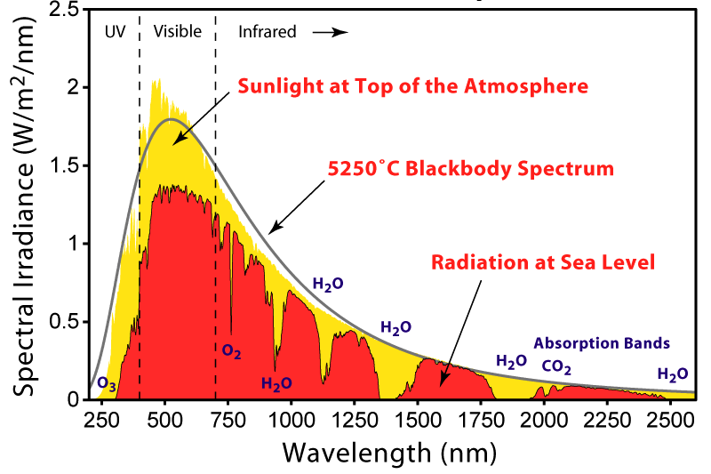
Solar Radiation Spectrum

Slide 17
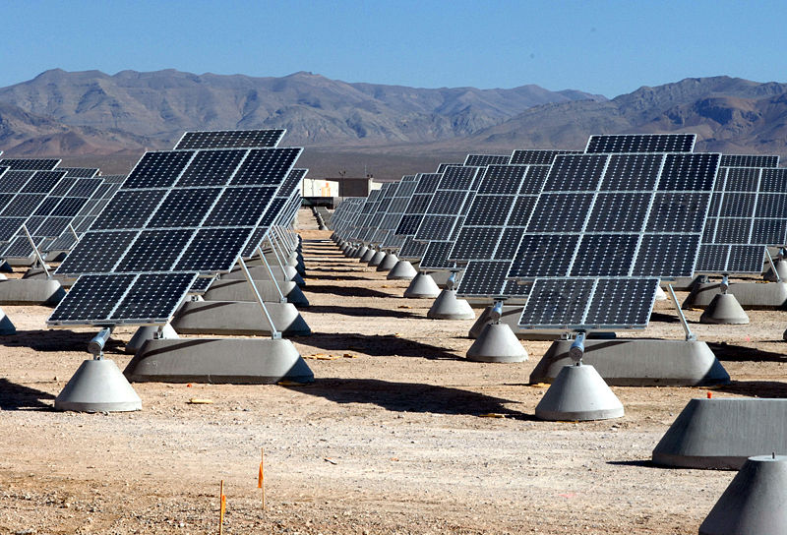
Photovoltaics

Slide 18
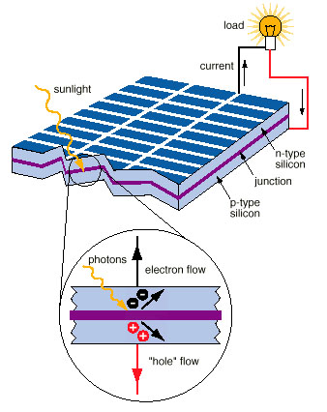
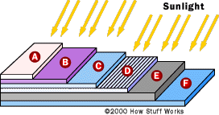

Solar Cell

Slide 19
Semiconductor Behavior

Slide 20
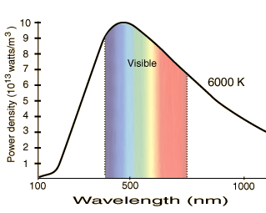
Difficulties to overcome:
This is an approximation to the actual solar spectrum.
Silicon (common solar cell material) “needs” 1.1 eV photons.
The wavelength of such a photon is about 1100 nanometers.
Lower-energy photons can’t deposit their energy in silicon.
Higher-energy photons “waste” all of their energy except for the 1.1 eV.
Efficiency also decreases with temperature (and these things are going to get hot).

Slide 21
Effect of Bandgap
Ideal maximum (extraterrestrial) solar energy conversion efficiency and actual measured value (square)

Slide 22
Efficiency
The I-V curve of a PV cell, and the ideal curves for different illumination levels
Goswami and Kreith, Energy Conversion, CRC Press, 2008.
Effect of operating temperature
Goswami and Kreith, Energy Conversion, CRC Press, 2008.

Slide 23
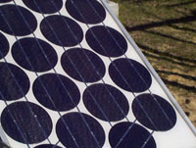
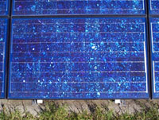
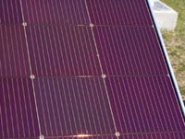
Commercial Solar Cells
Single crystal silicon (Tesla, efficient but expensive)
Poly-Crystal Silicon (cheaper but less efficient; more so for amorphous Si)
Thin Films (flexible for integration)
Polymer, dye-sensitized cells, organic, electrically conducting plastics, Perovskites, etc.

Slide 24
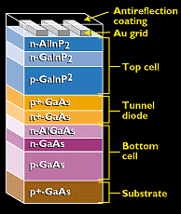
Solution: “stack” solar cells made of different materials.
Can be 45+% efficient! However, as the temperature goes up, the efficiency goes down.

Slide 25
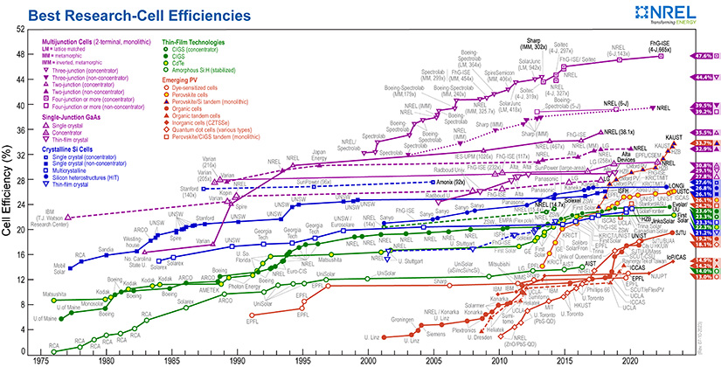
Efficiency Over Time

Slide 26
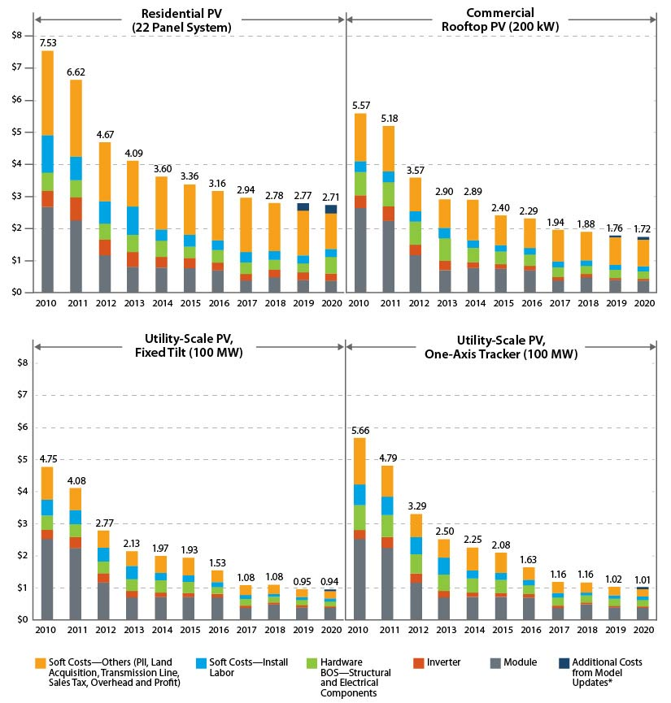
Cost Over Time (NREL)

Slide 27
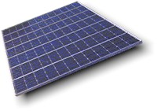
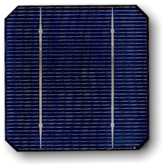

Cells, Modules and Arrays

Slide 28
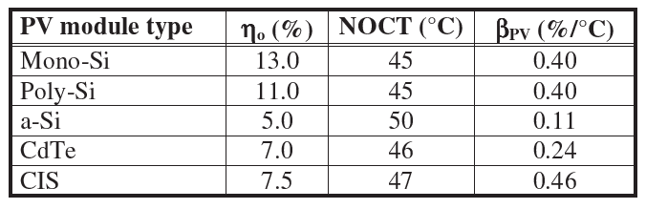
PV Module Characteristics for Standard Technologies

Slide 29
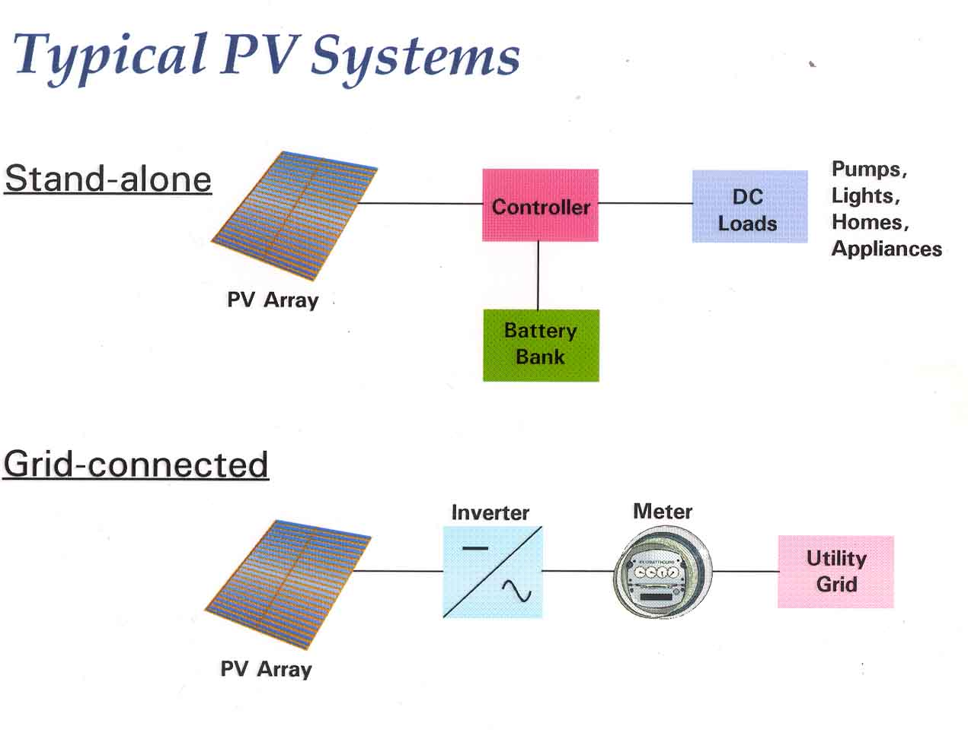
Typical PV Systems

Slide 30
PV Farms
Fixed tilt systems: Cheapest. Ideal tilt is the azimuth angle ± 15–20 degrees (usually less than azimuth angle because of wind deflection).
Single-axis Tracking (N-S): Boosts efficiency by up to 25%, typical rotation range is 45 degrees East/West.
Two-axis tracking: Maximum power, as high as 40% over fixed tilt systems. High structural, space, and cost requirements.
Photovoltaic Solar Energy, Reinder et al, Ed., Wiley, 217

Slide 31
Other Factors

